Slide 1


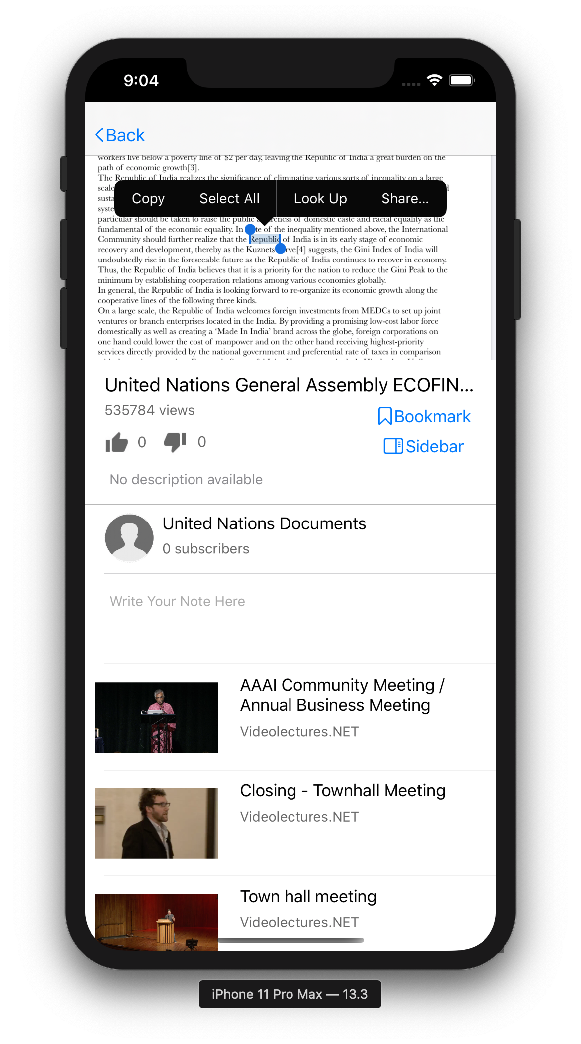

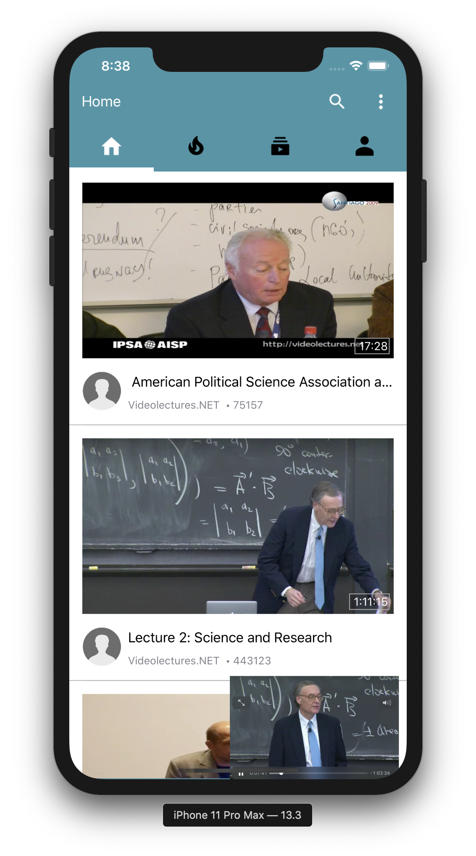
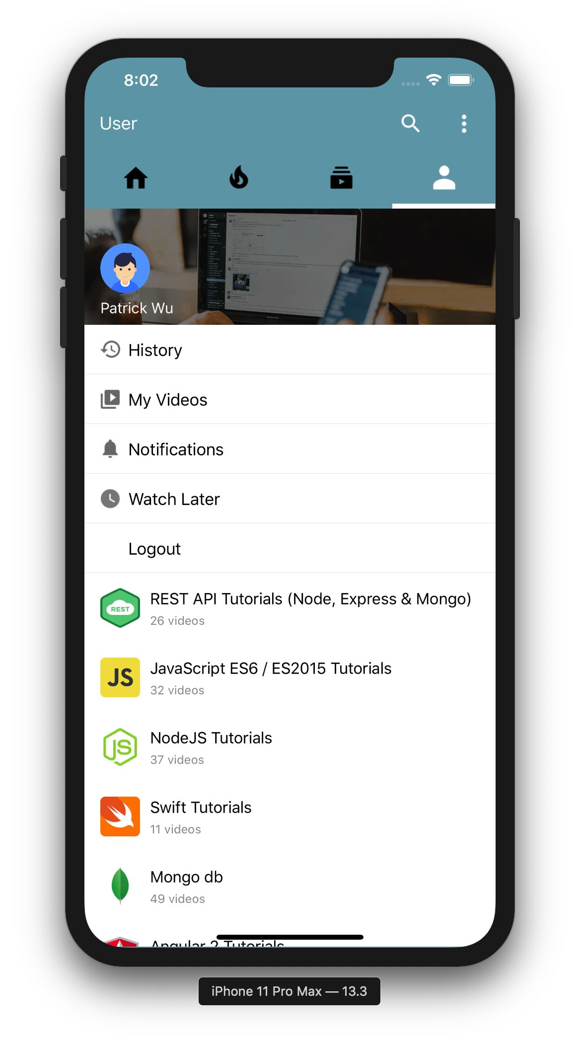
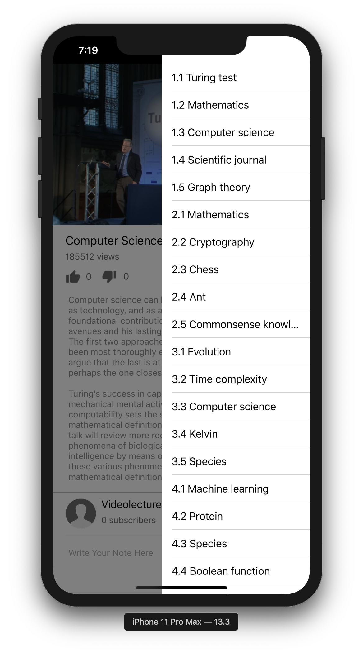





Team 4
Patrick Wu, Yinrui Hu
Mobile
Rethinking Mobile Learning on iOS
Abstract
Key Requirements
X5GON is an industrial leading Open Education Resource Provider. In this project, we worked with the UCL’s X5GON research team to deliver a mobile application that provides users with an authentic and mobile-friendly X5GON experience and learning materials catered to their needs.
With this project, the X5Learn system would be able to attract more customers from the mobile platform and enable its users to have all their customised X5Learn experience at hand anytime, anywhere.
Adaptive. | Informative. | Customisable.
Supporting all content types on mobile, including but not limited to videos, audios, PDFs and text contents. | Delivering authentic Open Education Material through information feeds on mobile with X5Learn’s smart algorithms. Offering quick summary generated by AI understanding the whole content in no time. | Providing user-tailored contents with a single click of logging in, plus notes, bookmarks and ML-algorithms-backed learning routes.
Solutions and Showcases
Simple yet educative.
Content feeds, quick thumbnail at-a-glance, AI bullet-points and summary, are only taps away from launching the X5GON Mobile application.
What’s more, utilise these on the side while not stopping the learning journey.
Login, get personalised.
Unlock X5GON Mobile’s full potential with a quick login. Subscribe to any open course provider, let it be MIT Open Courseware, Stanford Online or even UCL.
History, watch lists, bookmarks and lesson paths help track learning progress, and feeds to significantly better advice from X5Learn’s ML algorithm.
Diverse content delivery at its Core.
Taking full advantage of the comprehensive toolset provided in the iOS SDK, X5GON Mobile now supports :
• Videos up to 4K60FPS | • Lossless audio
• Markdown HTML | • PDFs
Technology
Blazingly fast loading speed.
We utilised extensive pre-fetching and multi-threaded loading techniques to balance network load and enhance our performance. Delivering significantly more responsive and smoother user experience than our competitor.
MVC Architecture. Swift. The Natives and Classics.
As a typical client-based application on iOS, we adopted the MVC Architecture and Swift Development Language. See below for more details.
All contents in this poster, with the exception of the project's proprietary brand name and logo, are distributed and published under the following license.
Creative Commons Attribution-NonCommercial-NoDerivatives 4.0 International Public License
Obtain copy here:
https://creativecommons.org/licenses/by-nc-nd/4.0/legalcode
Views:
MainViews
PlayerViews
NavViews
View Controllers
API Adapters
Main Controller
Data Models

